Slide 1
Machine Learning
By David Yuan

Slide 2
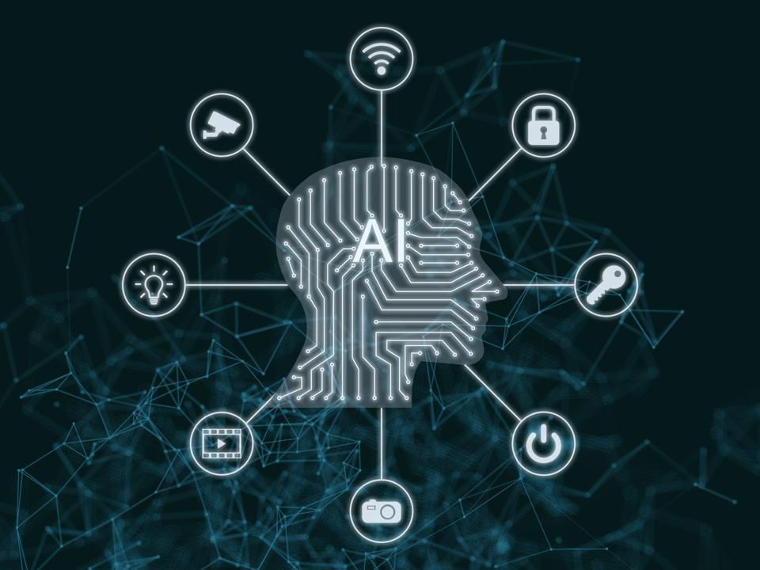
What is machine learning?
It’s not magic!
Using data to teach computers
Lots of statistics!

Slide 3


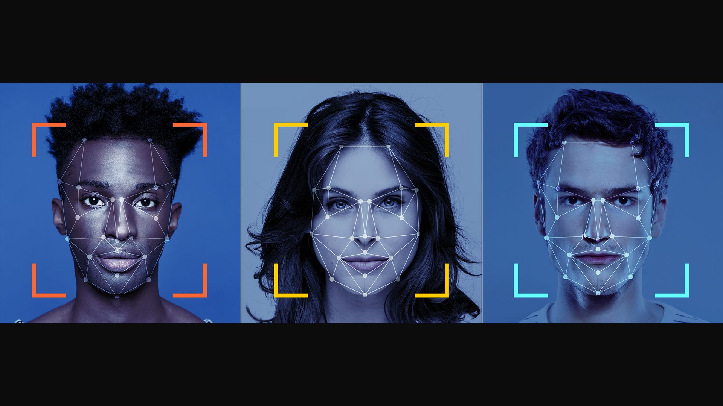
Ways to use machine learning

Slide 4
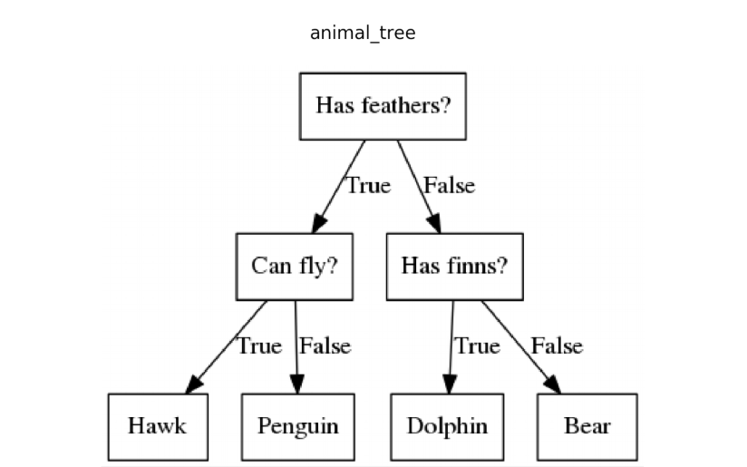
Decision Trees
Computers can build this using data!
You have to tell them what’s most important
Kind of similar to how we think!

Slide 5
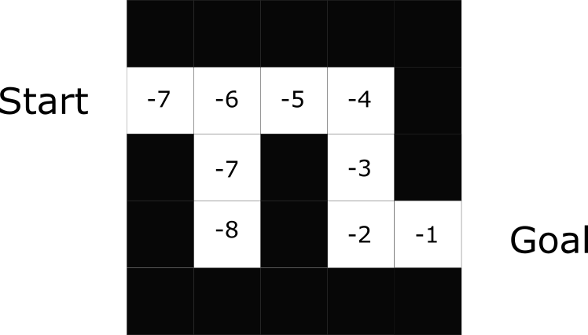
Reinforcement Learning
Computers try things, and we tell them how they do
You tell them the rewards!
We think like this sometimes too!

Slide 6
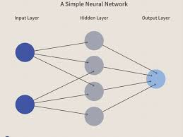
Neural Networks
Computers do some kind of computation and produce a result
We tell them how to transform
No real person actually thinks like this

Slide 7
